Slide 1
Cloud platform and application

Slide 2
Web Services
A web service is any piece of software that makes itself available over the internet and uses a standardized XML messaging system. XML is used to encode all communications to a web service. For example, a client invokes a web service by sending an XML message, then waits for a corresponding XML response. As all communication is in XML, web services are not tied to any one operating system or programming language—Java can talk with Perl; Windows applications can talk with Unix applications.

Slide 3
Components of Web Services
The basic web services platform is XML + HTTP. All the standard web services work using the following components −
SOAP (Simple Object Access Protocol)
UDDI (Universal Description, Discovery and Integration)
WSDL (Web Services Description Language)

Slide 4
SOAP (Simple Object Access Protocol)
SOAP stands for “Simple Object Access Protocol.” It is a transport-independent messaging protocol. SOAP is built on sending XML data in the form of SOAP Messages. A document known as an XML document is attached to each message. Only the structure of the XML document, not the content, follows a pattern. The best thing about Web services and SOAP is that everything is sent through HTTP, the standard web protocol.

Slide 5
UDDI (Universal Description, Discovery, and Integration)
UDDI is a standard for specifying, publishing and discovering a service provider’s online services. It provides a specification that aids in the hosting of data via web services. UDDI provides a repository where WSDL files can be hosted so that a client application can discover a WSDL file to learn about the various actions that a web service offers. As a result, the client application will have full access to the UDDI, which serves as a database for all WSDL files.

Slide 6
WSDL (Web Services Description Language)
If a web service can’t be found, it can’t be used. The client invoking the web service should be aware of the location of the web service. Second, the client application must understand what the web service does in order to invoke the correct web service. The WSDL, or Web services description language, is used to accomplish this. The WSDL file is another XML-based file that explains what the web service does to the client application. The client application will be able to understand where the web service is located and how to use it by using the WSDL document.

Slide 7
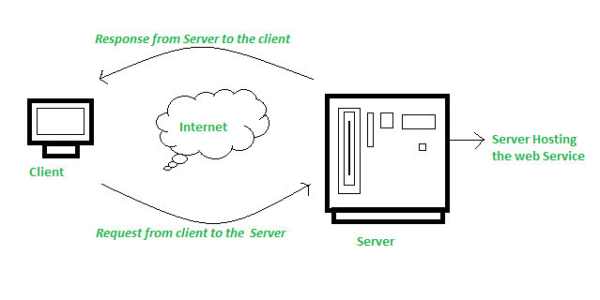
How Does Web Service Work?

Slide 8
AWS(Amazon web service)
Amazon Web Services (AWS) began offering IT infrastructure services to businesses in the form of web services -- now commonly known as cloud computing. One of the key benefits of cloud computing is the opportunity to replace up-front capital infrastructure expenses with low variable costs that scale with your business. With the Cloud, businesses no longer need to plan for and procure servers and other IT infrastructure weeks or months in advance. Instead, they can instantly spin up hundreds or thousands of servers in minutes and deliver results faster.
Amazon Web Services provides a highly reliable, scalable, low-cost infrastructure platform in the cloud that powers hundreds of thousands of businesses in 190 countries around the world. With data center locations in the U.S., Europe, Brazil, Singapore, Japan, and Australia, customers across all industries are taking advantage of the following benefits:

Slide 9
Benefits of using AWS
Low Cost :AWS offers low, pay-as-you-go pricing with no up-front expenses or long-term commitments. They are able to build and manage a global infrastructure at scale, and pass the cost saving benefits onto us in the form of lower prices.
Agility and Instant Elasticity: AWS provides a massive global cloud infrastructure that allows you to quickly innovate, experiment and iterate. Instead of waiting weeks or months for hardware, you can instantly deploy new applications, instantly scale up as your workload grows, and instantly scale down based on demand. Whether you need one virtual server or thousands, whether you need them for a few hours or 24/7, you still only pay for what you use.

Slide 10
Benefits….
Open and Flexible: AWS is a language and operating system agnostic platform. You choose the development platform or programming model that makes the most sense for your business. You can choose which services you use, one or several, and choose how you use them. This flexibility allows you to focus on innovation, not infrastructure
Secure: AWS is a secure, durable technology platform with industry-recognized certifications and audits: PCI DSS Level 1, ISO 27001, FISMA Moderate, FedRAMP, HIPAA, and SOC 1 (formerly referred to as SAS 70 and/or SSAE 16) and SOC 2 audit reports. AWS services and data centers have multiple layers of operational and physical security to ensure the integrity and safety of your data.

Slide 11
Google App Engine.
Overview
Google App Engine (GAE) is a Platform as a Service (PaaS) cloud computing platform for developing and hosting web applications in Google-managed data centers.
Google App Engine lets you run web applications on Google's infrastructure.
Easy to build.
Easy to maintain.
Easy to scale as the traffic and storage needs grow.
Free ???
Yes, free for upto 1 GB of storage and enough CPU and bandwidth to support 5 million page views a month. 10 Applications per Google account.

Slide 12
How is GAE used?
GAE is a fully managed, serverless platform that is used to host, build and deploy web applications. Users can create a GAE account, set up a software development kit and write application source code. They can then use GAE to test and deploy the code in the cloud.
Features
Managed infrastructure. Google manages the back-end infrastructure for users. This approach makes GAE a serverless platform and simplifies API management.
Several programming languages. GAE supports a number of languages, including GO, PHP, Java, Python, NodeJS, .NET and Ruby. It also supports custom runtimes.

Slide 13
Features contd…
Support for legacy runtimes. GAE supports legacy runtimes, which are versions of programming languages no longer maintained. Examples include Python 2.7, Java 8 and Go 1.11.
Application diagnostics. GAE lets users record data and run diagnostics on applications to gauge performance.
Security features. GAE enables users to define access policies with the GAE firewall and managed Secure Sockets Layer/Transport Layer Security certificates for free.
Traffic splitting. GAE lets users route requests to different application versions.

